Slide 1

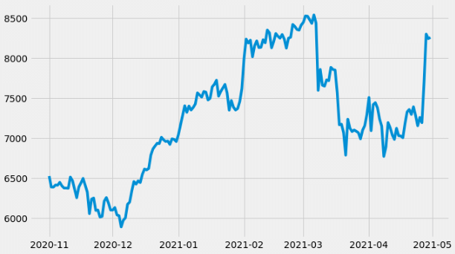
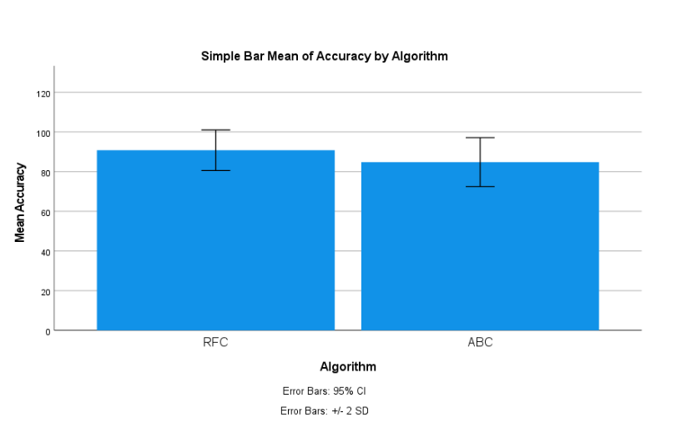
Students Name: A. Ajay
Registration number: 192124147
Guided By: Dr. R. Dinesh kumar
Ms. Poorani.S
Guided by Dr. Mary Valantina. G
Stock market price prediction using K- Nearest Neighour (KNN) in combination with Linear Regression
Machine Learning in Financial Markets: Machine learning techniques have become essential tools in financial markets for analyzing complex data and making predictions. These algorithms can learn from historical market data to forecast future trends and prices.
K-Nearest Neighbors (KNN) for Local Similarity: KNN is a supervised learning algorithm used for both classification and regression tasks.
Linear Regression for Trend Analysis: Linear Regression is a fundamental statistical method for modeling relationships between variables. In the context of stock price prediction, Linear Regression helps capture global trends and overall patterns in market data to estimate future prices.
Combining KNN and Linear Regression: By combining KNN's ability to capture local similarities with Linear Regression's capability to analyze broader trends,
INTRODUCTION
Fig 1:Stock Market Prediction
MATERIALS AND METHODS
Data Cleaning:
Remove or correct any errors or inconsistencies in the collected data to ensure data quality.
Depending on the dataset, search for duplicate rows using all or a subset of the columns.
Data Preprocessing:
Handle missing values: Impute missing values using mean, median, or mode.
Handle outliers: Identify and handle outliers using techniques like Z-score, IQR, or removing them.
KNN Model:
Define the logistic regression model.
Train the model using the training set.
Calculate accuracy, precision, recall, and F1 score to measure the model's effectiveness.
Data Collection:
Data was collected on perpetrator attacks.
Preprocessing the data, including cleaning, transforming, and encoding.
Results:
Data was analyzed and used Logistic Regression in comparison with the Decision Tree Algorithm.
Accuracy of 85 percent.
Conclusion:
Summarize the findings from the analysis.
Conclude the effectiveness of Logistic Regression and Decision Tree algorithms in predicting perpetration attacks.
Linear Regression Model:
Define the decision tree model.
Train the model using the training set.
Calculate performance metrics such as accuracy, precision, recall, and F1 score.
Stock Market Prediction
RESULT
 | Levene’s Test for equality of variance |  |  |  | T- test for equality of means
 | F | Sig | T | DF | Sig | Mean | STD. Error | Lower | Upper
Equal variance assumed | .787 | .361 | 5.676 | 18 | <.001 | 0.8000 | .01409 | .05039 | .10961
Equal variance not assumed |  |  | 5.676 | 16 | <.001 | 0.8000 | .01409 | .05025 | .10975
Fig 2:LSTM and RF
Table 1: Independent Sample Test
DISCUSSION AND CONCLUSION
Improved Predictive Accuracy: The combination of KNN and Linear Regression leads to improved accuracy by leveraging both local and global information embedded in the data.
Enhanced Robustness and Adaptability: The hybrid model enhances robustness and adaptability by reducing model biases and overfitting risks, resulting in more reliable predictions across different market scenarios.
Valuable Insights for Decision-Making: The interpretability of the combined model provides valuable insights into the factors influencing stock prices, enabling informed.
The combination of KNN and Linear Regression leverages the strengths of both approaches: KNN's ability to capture local patterns and nonlinear relationships, and Linear Regression's simplicity and interpretability.
Linear Regression, on the other hand, models the relationship between independent variables and the target variable using a linear equation, making predictions based on the weighted sum of input features.
BIBLIOGRAPHY
Hastie, T., Tibshirani, R., & Friedman, J. (2009). The Elements of Statistical Learning: Data Mining, Inference, and Prediction (2nd ed.). Springer. Altman, E. I. (1968).
Financial ratios, discriminant analysis and the prediction of corporate bankruptcy. Journal of Finance, 23(4), 589-609. Cover, T., & Hart, P. (1967).
Nearest neighbor pattern classification. IEEE Transactions on Information Theory, 13(1), 21-27. Zhang, L., Cao, F., & Wang, X. (2018).
Shakya, Subarna, George Papakostas, and Khaled A. Kamel. 2023. Mobile Computing and Sustainable Informatics: Proceedings of ICMCSI 2023. Springer Nature.
Mishra, Sandhya, and Devpriya Soni. 2022. “Implementation of ‘Smishing Detector’: An Efficient Model for Smishing Detection Using Neural Network.”
Sonowal, Gunikhan. 2020. “Detecting Phishing SMS Based on Multiple Correlation Algorithms.” Khan, Muhammad Sarwar. 2021. Frontiers in Molecular Pharming. Bentham Science Publishers.
A review of machine learning methods for stock market forecasting. Technological and Economic Development of Economy, 24(2), 336-355. Géron, A. (2019).
Hands-On Machine Learning with Scikit-Learn, Keras, and TensorFlow: Concepts, Tools, and Techniques to Build Intelligent Systems (2nd ed.). O'Reilly Media

